Slide 1

Homework 1 Database Creation and Simple Query Script Creation
IS664 Database Programming
FALL 2020
Professor HG Locklear
hlocklear@pace.edu

Slide 2
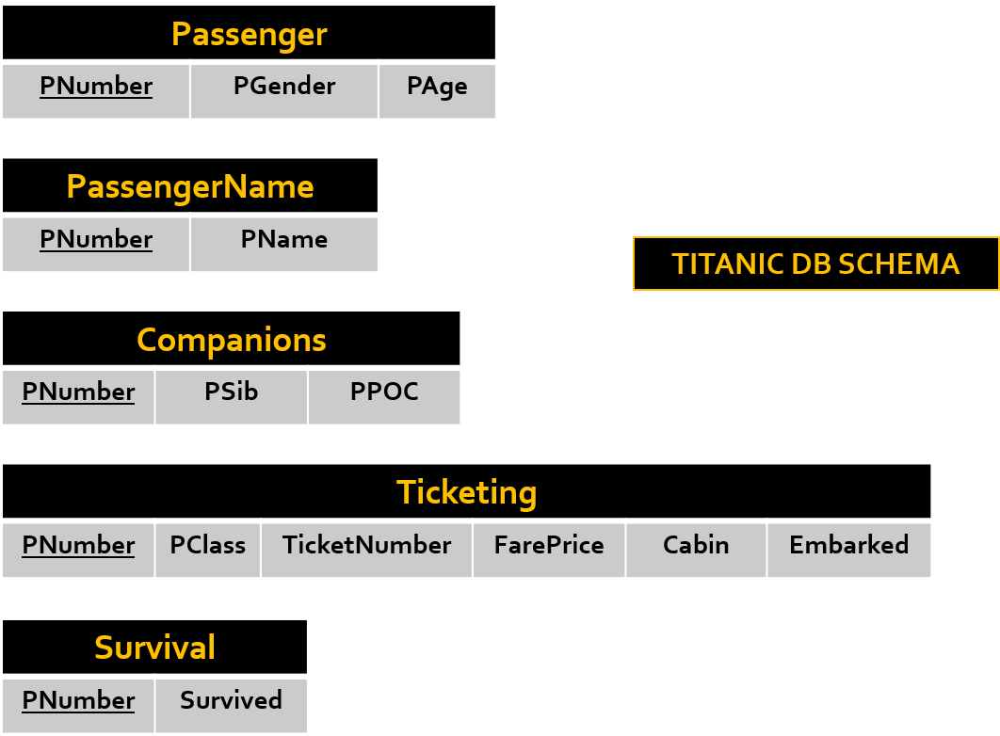
General
Code a SINGLE sql script that creates the database [Your Name]HW1 based on the schema shown on slide 2/3 and contains the code for the queries for each of the questions listed on slide 4.
After you have created the database, utilize the data files (one is provided for each table) to populate the tables in the database. DO NOT INCLUDE THESE FILES IN YOUR SUBMISSION…additionally, DO NOT COPY AND PASTE THE INSERT STATEMENTS INTO YOUR SCRIPT.
This assignment is DUE ON Thursday SEPT 17 by 6 PM.
Relations
Name | Contains
Passenger | Passenger Number, Gender, and Age
PassengerName | Passenger Number and Name
Companions | Passenger Number, Number of Siblings the Passenger has onboard, and the number of Parents and/or Children the Passenger has onboard
Ticketing | The Class of the Passenger’s Ticket, the Ticket Number, the Cost of the Ticket, the Passenger’s Cabin Number, and the Port where the Passenger embarked on the ship.
Survival | The Passenger Number and whether the Passenger Survived (0 No 1 Yes)
Required Constraints
All tables maintain referential integrity with the Passenger table
All Constraints must be named except for NOT NULL and DEFAULT
No Attribute may be NULL
The DEFAULT value for all numeric attributes is 0
The DEFAULT value for all non-numeric attributes is ‘UNK’

Slide 3
titanic Database Schema
Passenger
PNumber | PGender | PAge
Table | Data File Name
Passenger | Passenger.sql
PassengerName | PassengerName.sql
Companions | Companions.sql
Ticketing | Ticketing.sql
Survival | Survival.sql
1
PassengerName
PNumber | PName
HAS
1
Companions
PNumber | PSib | PPOC
1
Ticketing
PNumber | PClass | TicketNumber | FarePrice | Cabin | Embarked
Survival
PNumber | Survived

Slide 4
Required Queries
Query | Question
1 | How many passengers are female?
2 | How many passengers are male?
3 | How many passengers are over 30 years of age?
4 | How many passengers are under 30?
5 | How many female passengers survived?
6 | How many male passengers survived?
7 | How many female passengers over 30 survived?
8 | How many first class passengers survived?
9 | How many first class male passengers survived?
10 | How many first class female passengers survived?
Query | Question
11 | How many first class female passengers did not survive?
12 | How many first class male passengers did not survive?
13 | How many first class male passengers under 20 did not survive?
14 | How many first class female passengers under 20 did not survive?
15 | Maximum age of female survivors?
16 | Minimum age of female survivors?
17 | Mean age of female survivors?
18 | Maximum age of male survivors?
19 | Minimum age of male survivors?
20 | Mean age of male survivors?

